Slide 1
Interaction Management

Slide 2
Table of contents
We will talk about this
Call Details
Call Expense
Call Product Discussions/eDetailing
Call Attendees
Call Report

Slide 3
Table of contents
We will talk about this
Pre and Post Call Notes
Call submission configuration
Call Key Messages
Call Samples & Promotional items
Section Signals

Slide 4
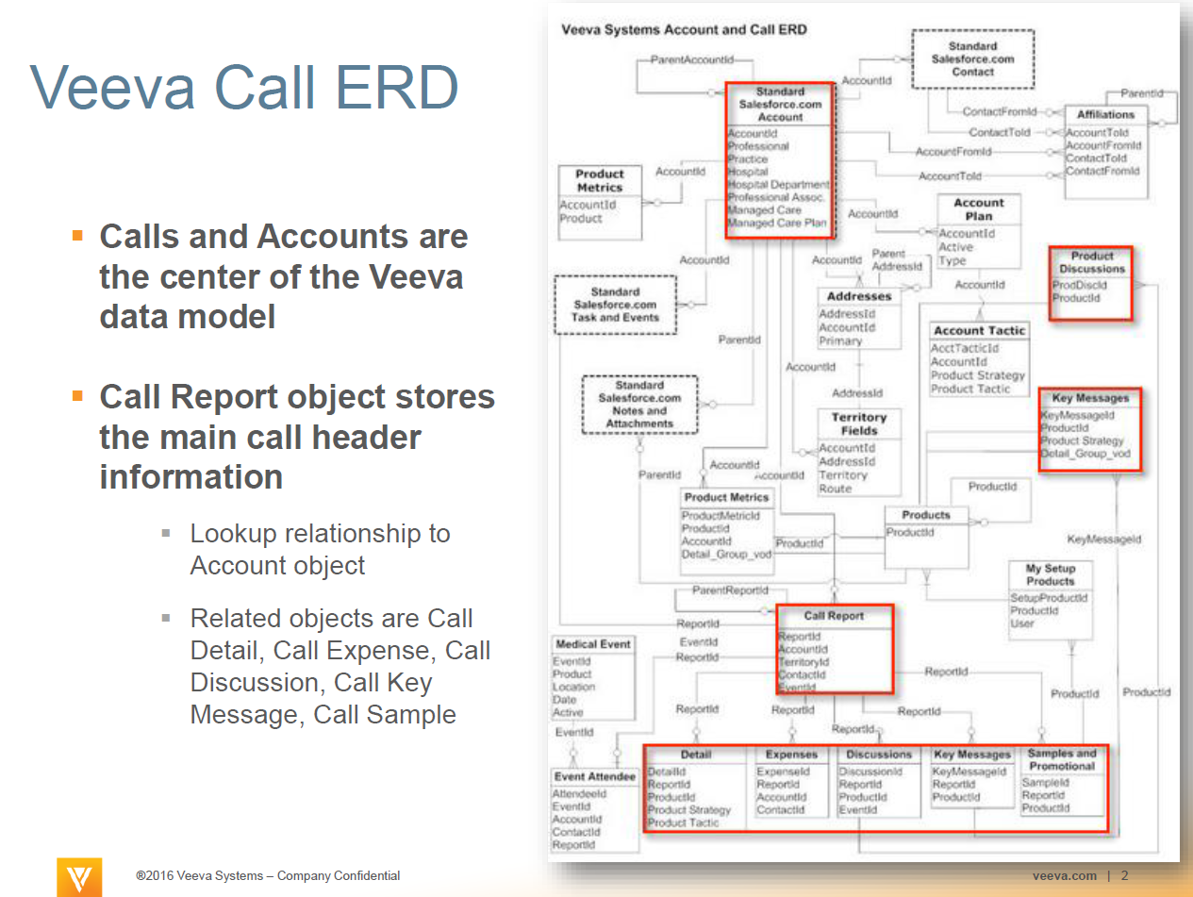

Slide 5
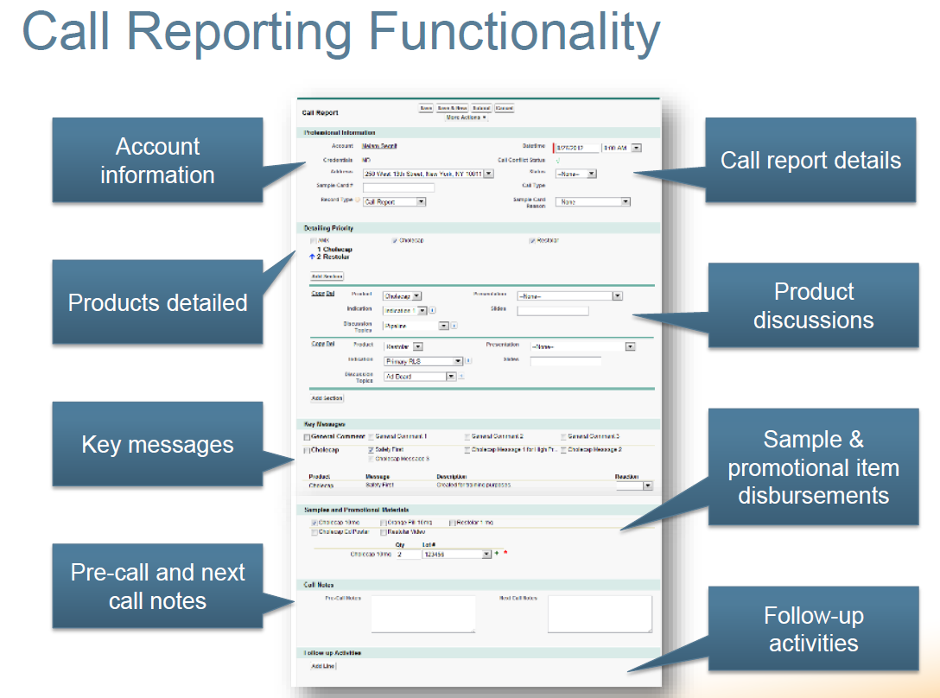

Slide 6
Call Report
Allows Users to capture the interactions with the key stake holders for promoting the company products
Scope includes CLM, Consent Capture, Account Plan, Medical Inquiries, Products and Approved Emails
Call Report Record Types in general are as below
Record Type | Description
Call_Report_vod | Used for Primary Care or Specialty sales representatives to record a Call with one or more HCPs
Event_vod | Used to record a call related to a Medical Events
MSL_Meeting_Brief_vod | Used to record an interaction between an HCP and a Medical Science Liaison
Meeting_Brief_vod | Used for a Managed Markets representative to record meetings with payers

Slide 7
Bayer Specific Call Report Record Types
Record Type | Description
BPH_Face2Face | Face2Face call
BPH_Face2Face_SIG | Make signature mandatory when dropping samples
BPH_Group_Call | Unique Activities on Group calls
BPH_Group_Call_SIG | Make signature mandatory when dropping samples on group calls
BPH_Non_Face2Face | Non Face2Face call
BPH_Remote_Group_Meeting | Remote Group Meeting
BPH_Remote_Meeting | Remote Meeting Activities

Slide 8
Call Types for Call Report
Call Type | Account Type | Product Detailing | Samples
Call Only | a Person OR a Business Account | No | No
Detail Only | Person | Yes | No
Sample Only | a Person OR a Business Account | No | Yes
Detail with Sample | Person | Yes | Yes
Group Detail | Business or Group Practice | Yes | No
Group Detail with Sample | Business Account | Yes | Yes
Event Only | against a Medical Event | No | No
Event Detail | against a Medical Event | Yes | No

Slide 9
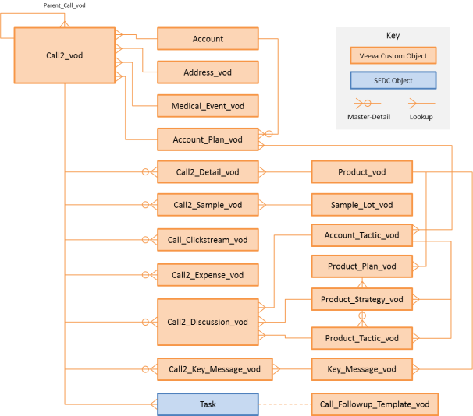
Call Reporting Data Model

Slide 11
Call2_vod
Details captured in the Object
Account
Status
Preferred Name
Record Type
Address
Call Type
CLM
Datetime
Double Visit
Duration
Accompanied By
Owner
Account Plan
Unplanned Call
Call Conflict Status
Also whether the Call is a Parent Call, Is Sample Call, expenses and such details are stored.

Slide 12
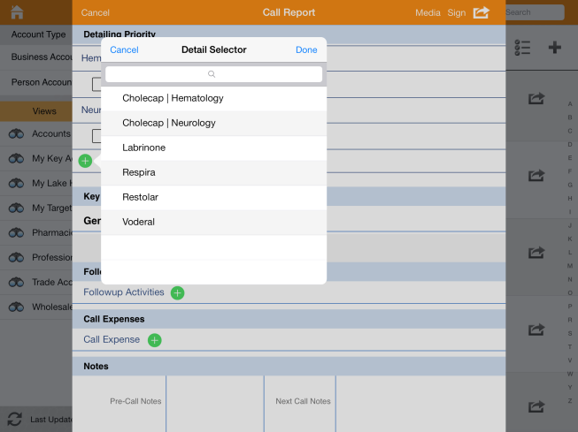
Call Details or Call2_Detail_vod
Allows Rep to select the products on which he wants to detail
Captures the products and detail topics on which the Rep has discussed during the Call
The list of available products and detail topics is based on marked products in the user’s My Setup page
If the Products are marked as favorite, they appear in the detailing section of the Call report by default.
If the Products are not marked as favorites in
My Setup, User needs to search for the products in
the detail selector and add them to the call by clicking
“Add Other” link at the bottom of the detailing
section to open the detail selector
To display Product Detailing on your Call Report page, place the zvod_detailing_vod field on the Call page layout

Slide 13
Call Expenses or Call2_Expense_vod
Expenses recorded on a call are stored in the Call Expenses custom object.
To display Expenses on your call report page, place the zvod_expenses field on the page.
Usually integrated with Concur for expense management and approvals.
Reps can add expense receipts to a Saved Call as image.
The name of the image changes to _Expense_Call2_vod <Timestamp in UTC> format. Images are stored in the attachment as JPG/JPEG images.
When a user submits a Call with an attached Expense receipt, the attachment is synced as part of the Auto-Send process.
Configuration for capturing receipts in CRM on Call2_vod object
FLS edit permission to the zvod_Add_Expense_Receipt_vod field
Place the zvod_Add_Expense_Receipts_vod field in a new section on page layout
FLS read permission to the Expense_Receipt_Status_vod field
Place the Expense_Receipt_Status_vod field on the Call2_vod object page layout.

Slide 14
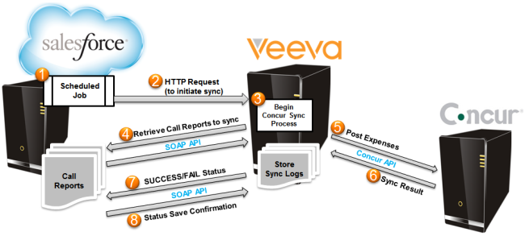
Concur Integration
There is Custom Setting Concur_Settings_vod__c for concur related fields but this has not been managed yet in Bayer Ac1
Multi-currency for calls can be configured to record expenses for different countries
Field mappings between Concur and Veeva CRM are updated to support multicurrency so that the mapping is based on the record currency, rather than the user currency
Why going for Concur:
1. To eliminate the need for reps to enter attendee information in two different systems.
2. Automatic posting of attendees improves data accuracy.
Data Flow in general is as below

Slide 15
Call Samples & Promotional Section
Enables Reps to drop Samples, promotional, and other items to Accounts on the Call Report
Provision for user to select specific products, quantities, and if applicable, lot numbers to be dropped to the account on the Call Report.
Samples can be dropped in an individual call or on a group call where an attendee can be selected as a recipient.
Few product types requires a valid license status and/or a signature.
On group calls where a signature is required, one recipient must be selected to sign for the product. For all other product types where a signature is not required, multiple attendees may be selected as a recipient.
In case if the mobile device is unavailable, paper-based sampling is supported on all platforms.
When a call is submitted, a Sample Transaction is generated for each selected Sample, and a Sample Order Transaction is generated for each selected BRC product.
These transactions are utilized in the sample tracking functionality within the Sample Management component of Veeva CRM.

Slide 16
The product types available for disbursement on a call report are:
Product Type | Definition | Valid License Required | Signature Required
Sample | Any product sample that is physically left at the call location | Y | Y
BRC | Any product sample that is requested to be sent via mail to a specified ship to address | Y | Y
Alternative Sample | Any means of obtaining a product sample that does not require a lot number for disbursement (co-pay cards and vouchers) | Y | Y
High Value Promotional Item | Any highly valued marketing or sales aid that is physically left at the call location | N | Y
Promotional Item | Any marketing or sales aid that is physically left at the call location | N | N
Reprint | Any medical reprint that is physically left at the call location | N | N
Custom | Any customer defined product type that is physically left at the call location | N | N

Slide 17
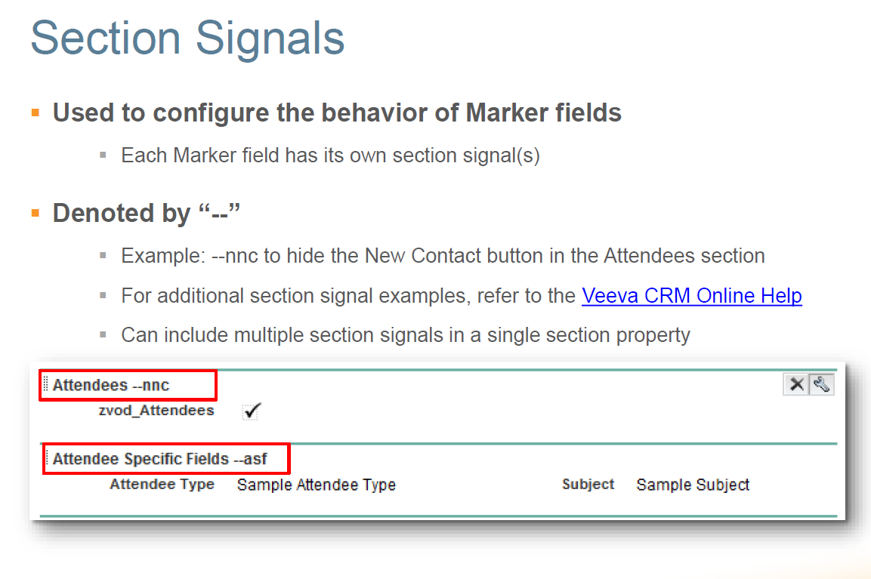
Section Signals

Slide 18
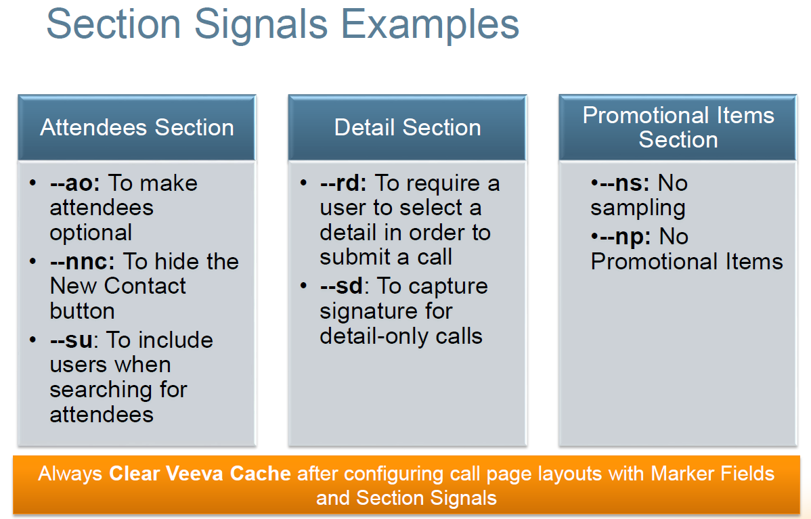

Slide 19
Section Signals used in IMCM Call page layouts
Samples & Promotional section signals
--nslns (No Sample License No Signature) : No Sampling license and no signature required.
--ra (Reset All): Enables the Clear Selection button allowing the user to quickly clear all Sample and Promotional Item entries.
--np (No promo items ) : No promo items in the sample column.
--nas (No Alternative Samples) : do not display the section for Alternative Samples in the Samples Section on the Call Report.
--mas : Enables mass sample items in the Samples section of the Call Report on iPad.
--gp :(Group Picklists) : Display samples and BRCs in drop-down boxes
--nb (No BRC) : No BRC/Sample Request product catalog records display.
--ns (No Samples) : No sample products and no lot #'s in the samples section.
Remote Meeting section signal
–rem : displays the Remote Meeting button as long as the section signal is present on the page layout
Attendees section signlas
--paa (Person Account Attendees) : Displays the attendees section for individual calls.
--nnc (No New Contacts): Suppresses the New Contact button.
--ao (Attendees Optional) : Defines attendees as a non-required field.

Slide 20
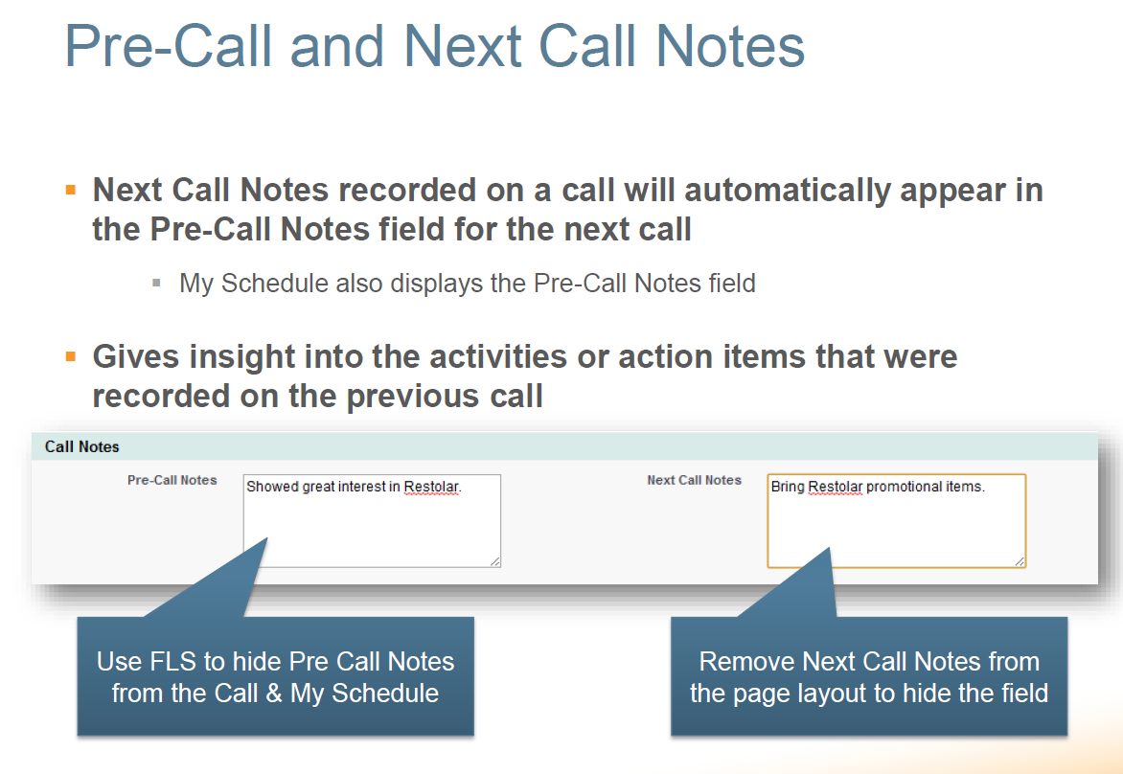

Slide 21
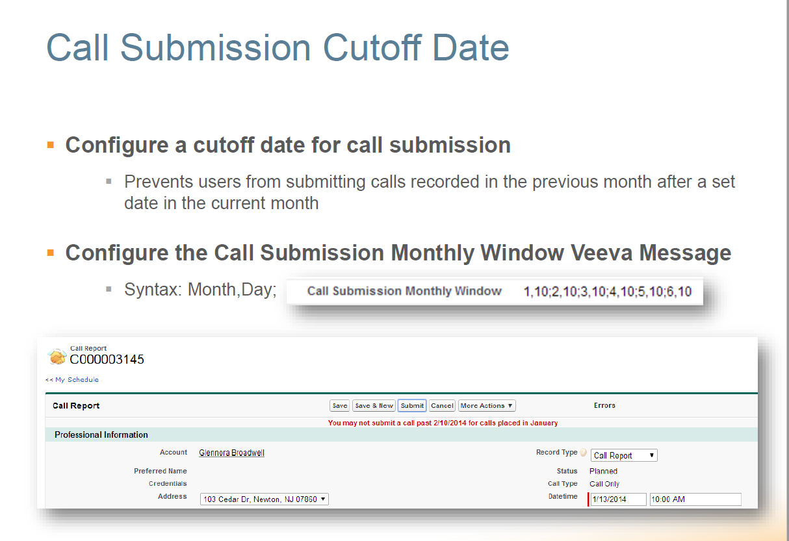

Slide 22
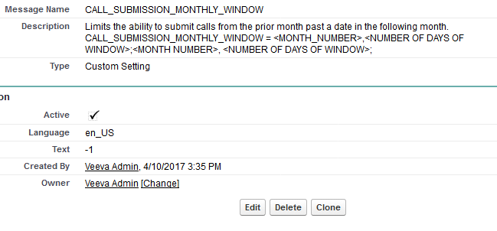
IMCM Call submission configuration

Slide 23
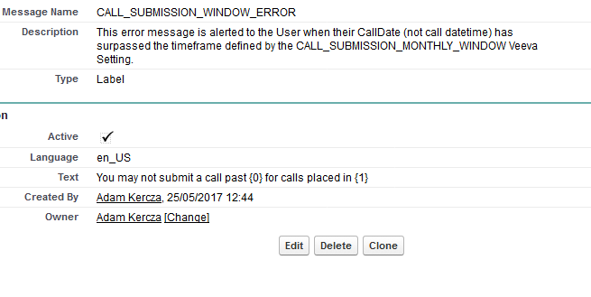
As per IMCM configurations, sales reps may not create/save/submit a call more than 30 days in the past

Slide 24
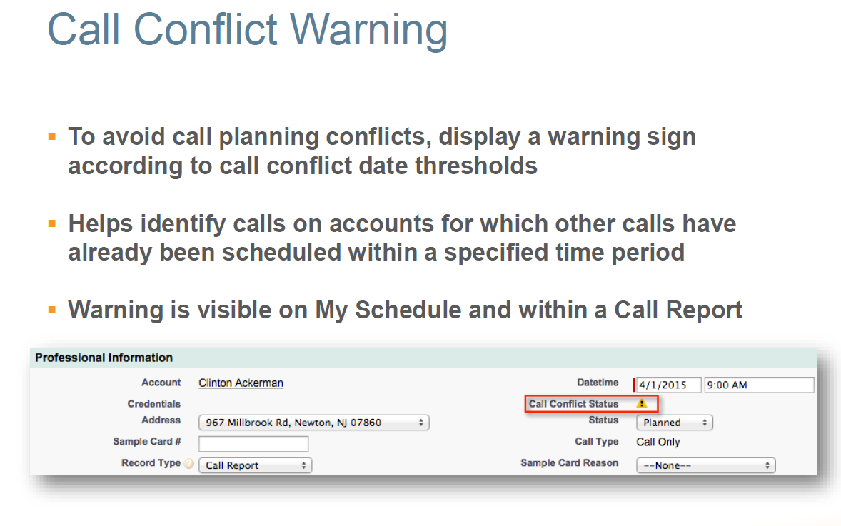

Slide 25
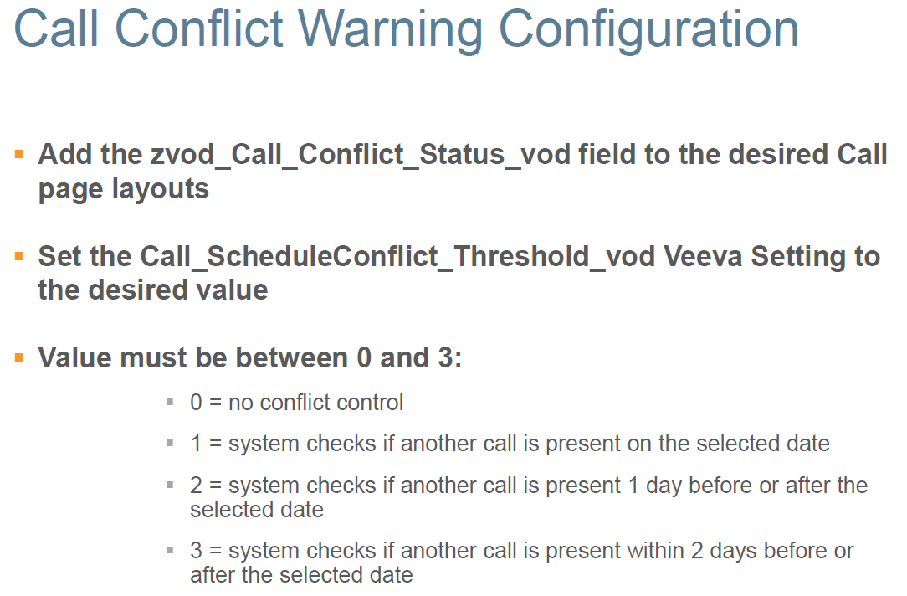

Slide 26
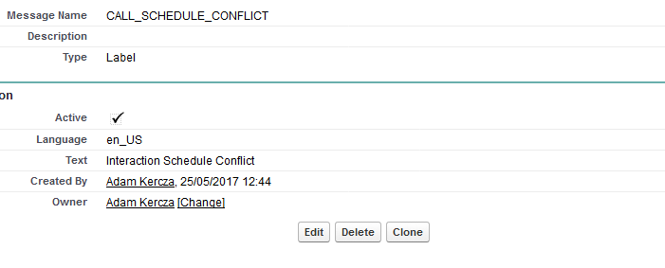

Slide 27
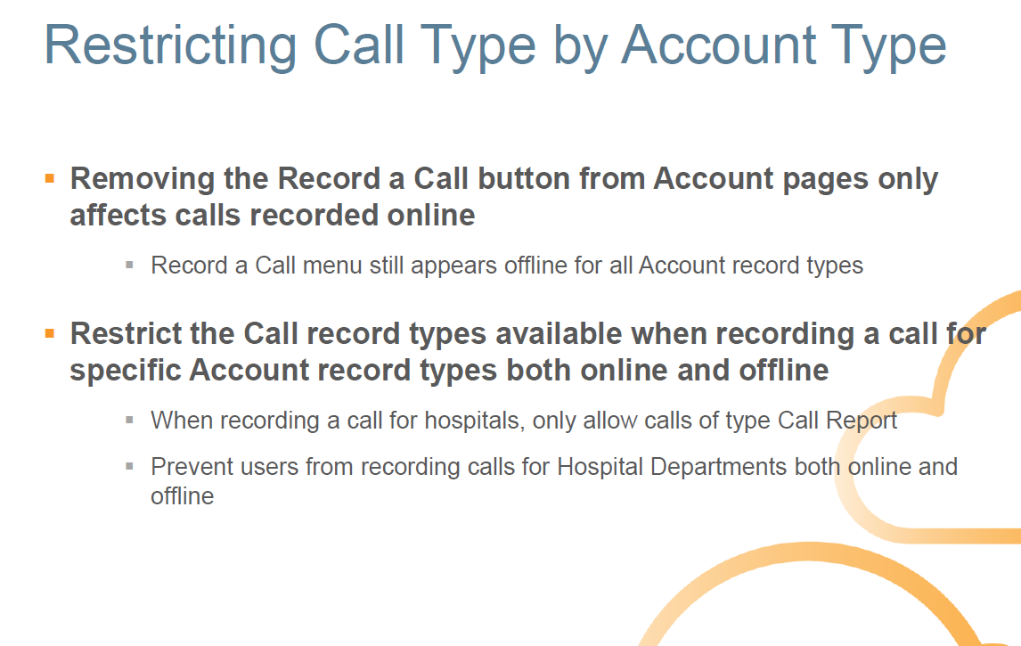

Slide 28
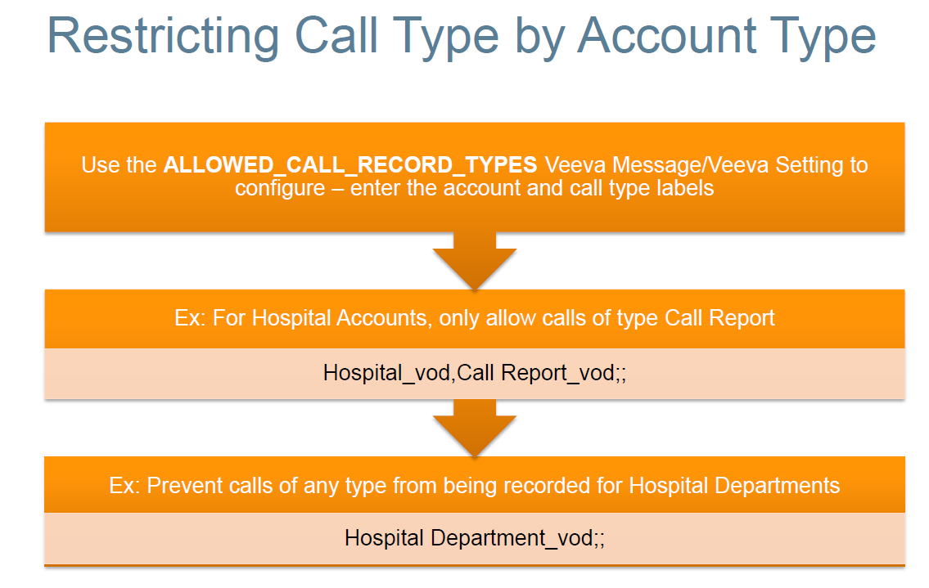

Slide 29
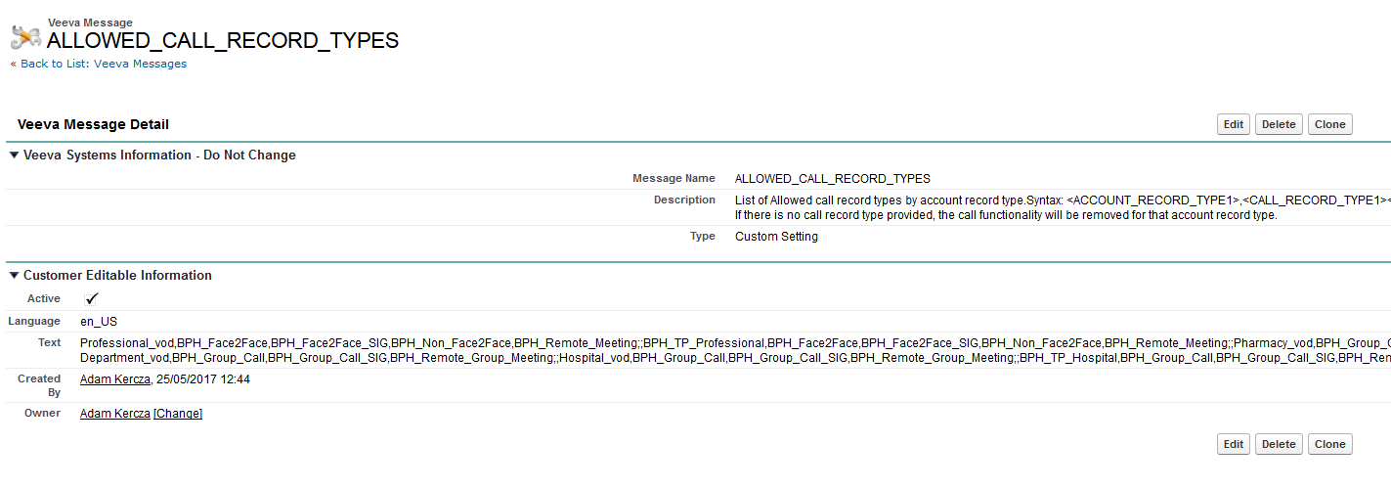
Current setting in IMCM

Slide 30
Thank you

